Slide 1

2020 Stack Overflow Developer Survey
Berk Büyükyıldız
Ahmet Erdem Sirel
Bengi Düzgel

Slide 2

What is our aim?
Predicting the annual compensation of professional developers based on stackoverflow annual developer survey.
Understranding factors related to compansation of a developer.

Slide 3


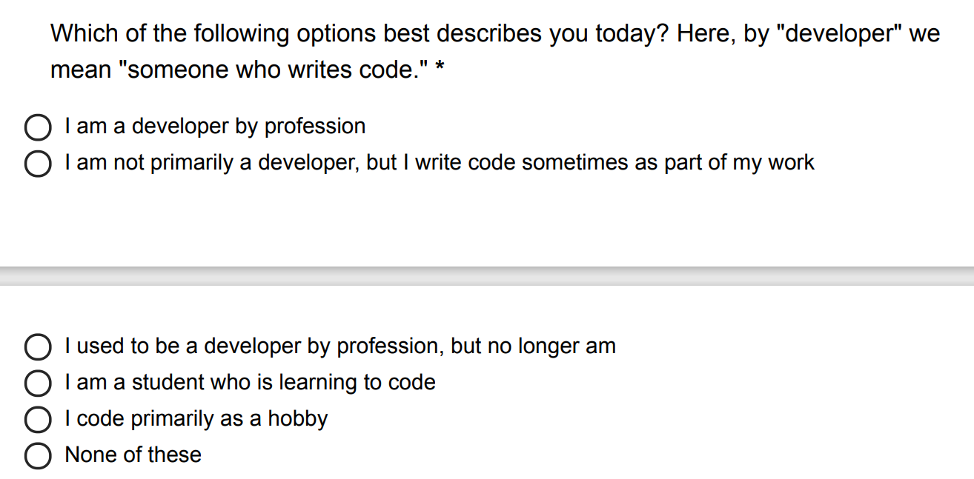
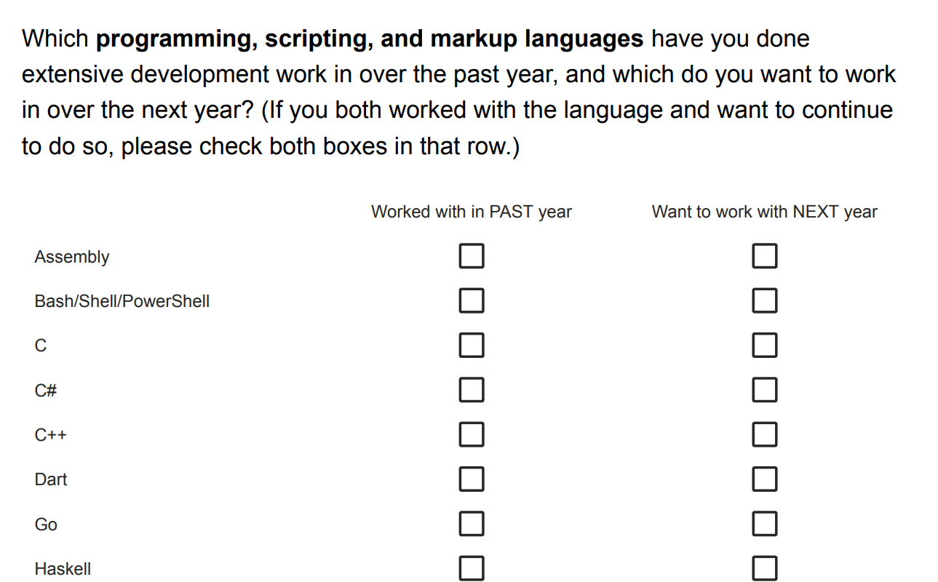
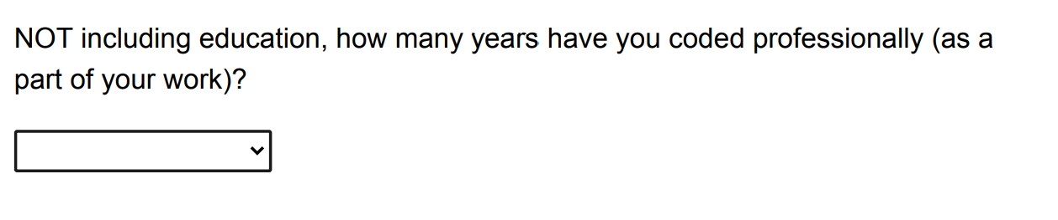
About the data
61 columns
64,461 rows
Categorical
Single Choice
Multiple Choice
Continues

Slide 4
Explanatory Analysis
Country
Age
Education Level
Job search
Job satisfaction
Technologies WorkedWith
DevType

Slide 5
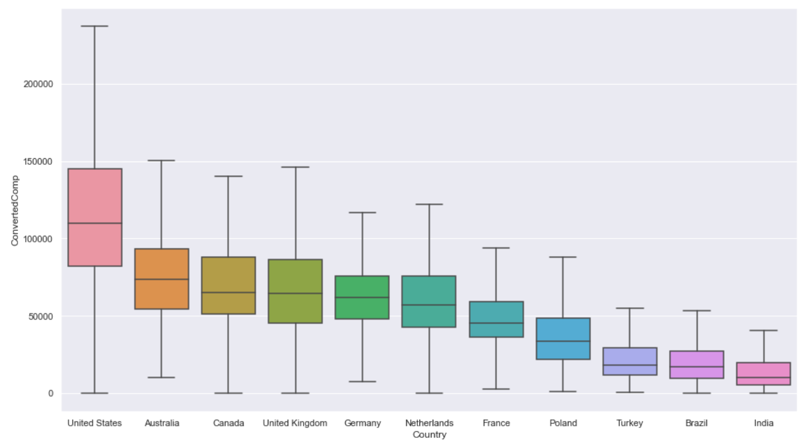
Professional Developer Compantsations by Country
Median salary in United States is +50% than other countries

Slide 6
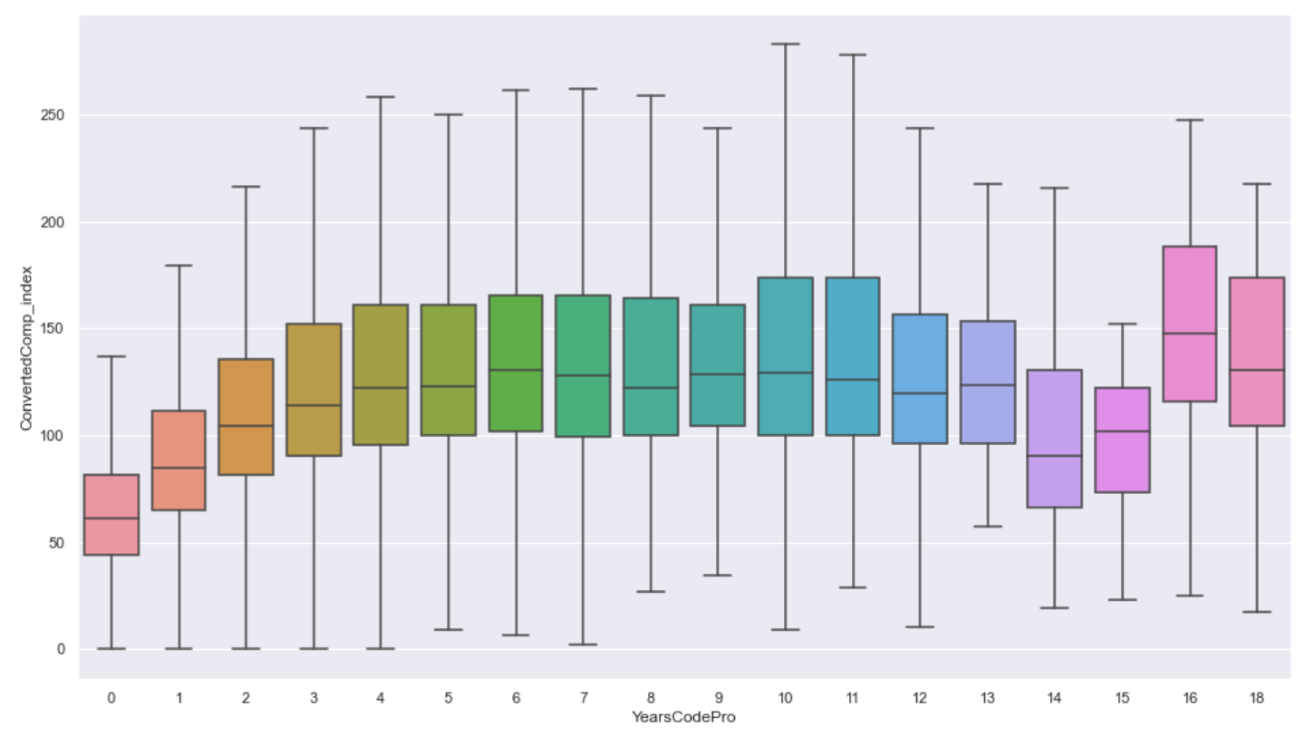
Professional Developer Compantsations by YearsCodePro
Compensation increase reach its steady state after 12 years.
(3 years period)

Slide 7
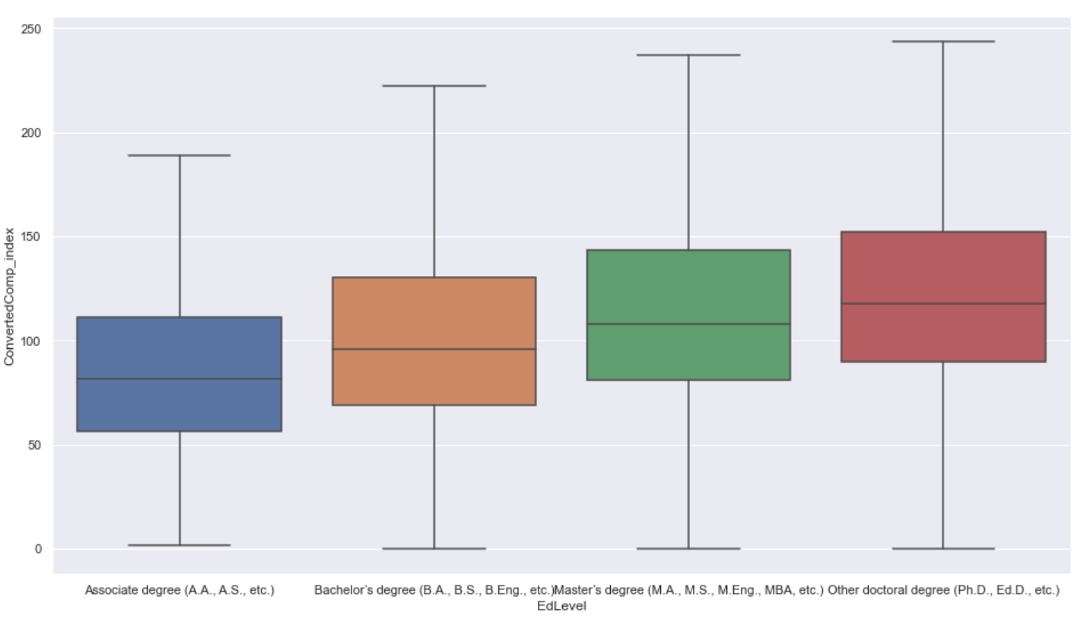
Professional Developer Compantsations by Education Level
Education level increase is propotional to increase in compensation

Slide 8
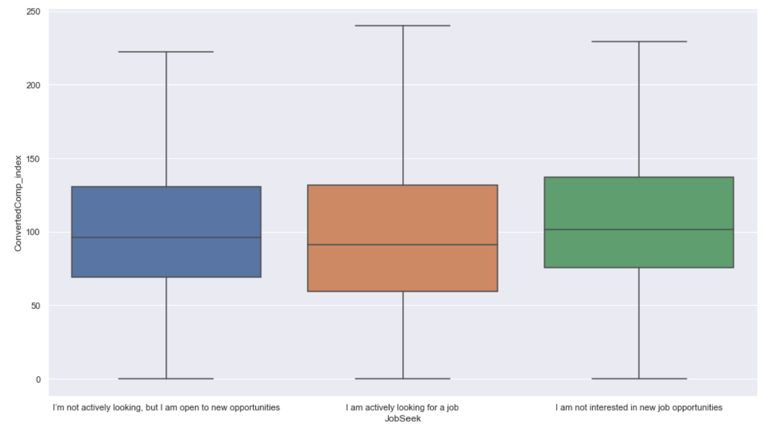
Job Search
Most of the developers are open to new job opportunities

Slide 9
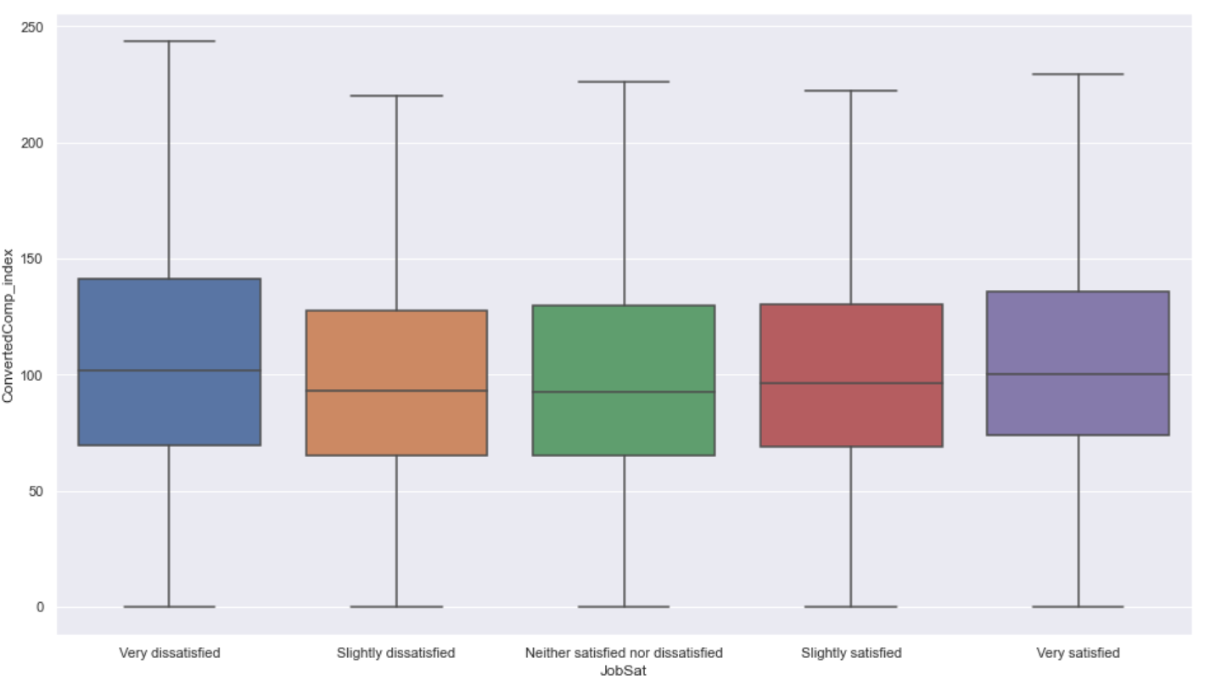
Job Satisfaction
Equal distribution of job satisfaction observed in the sample group

Slide 10
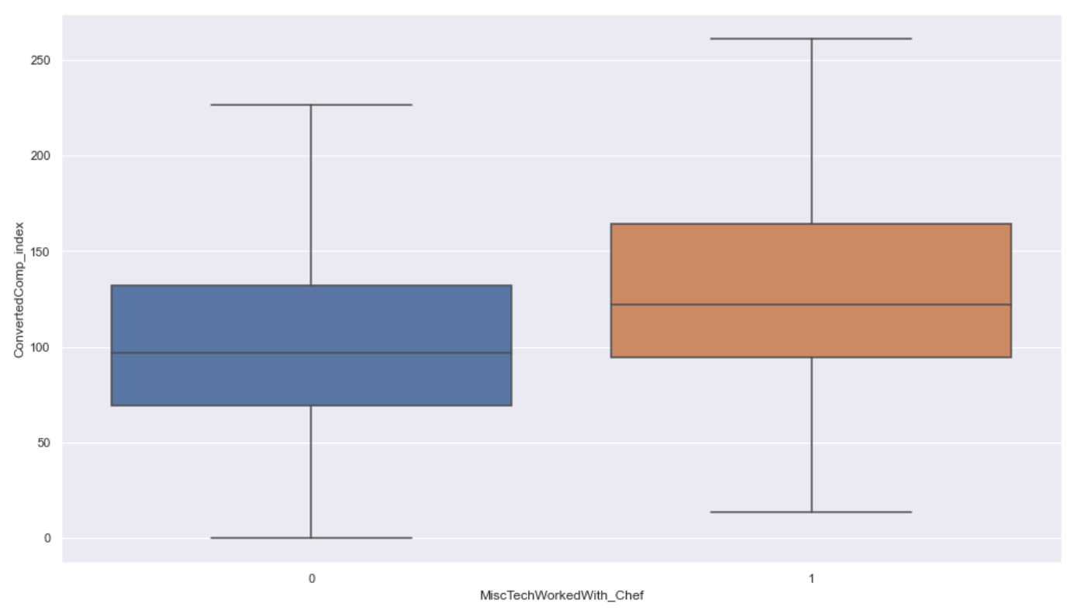
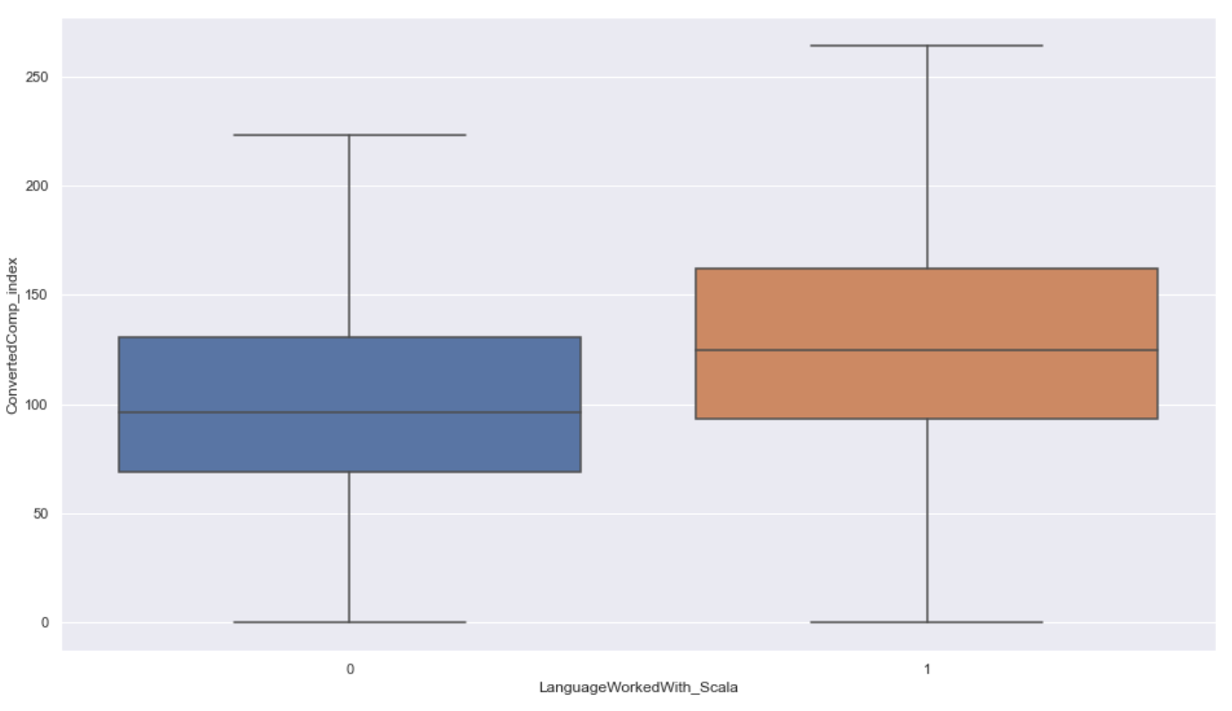
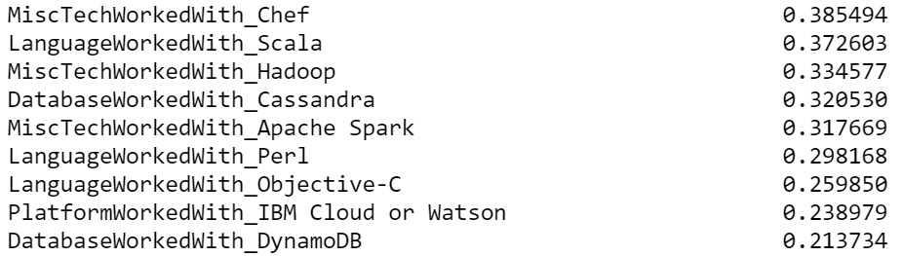
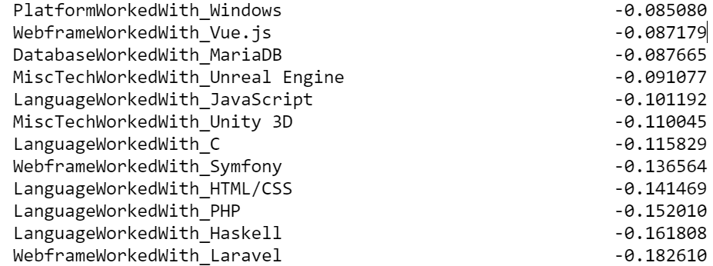
By technologies WorkedWith
High Leverage
Low Leverage
Chef
Scala

Slide 11
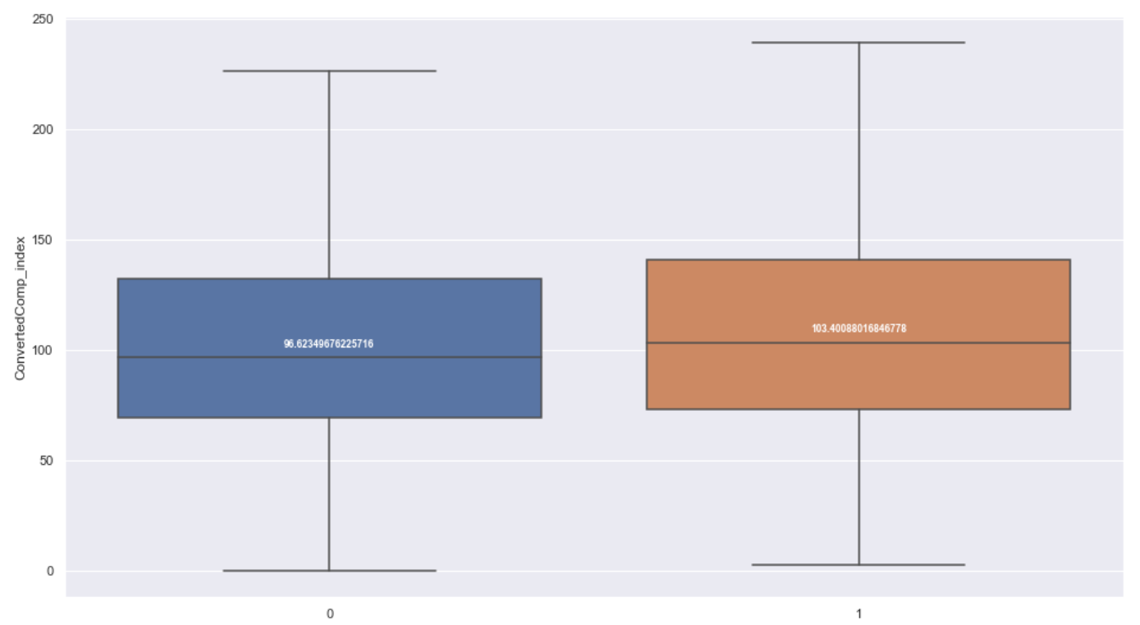

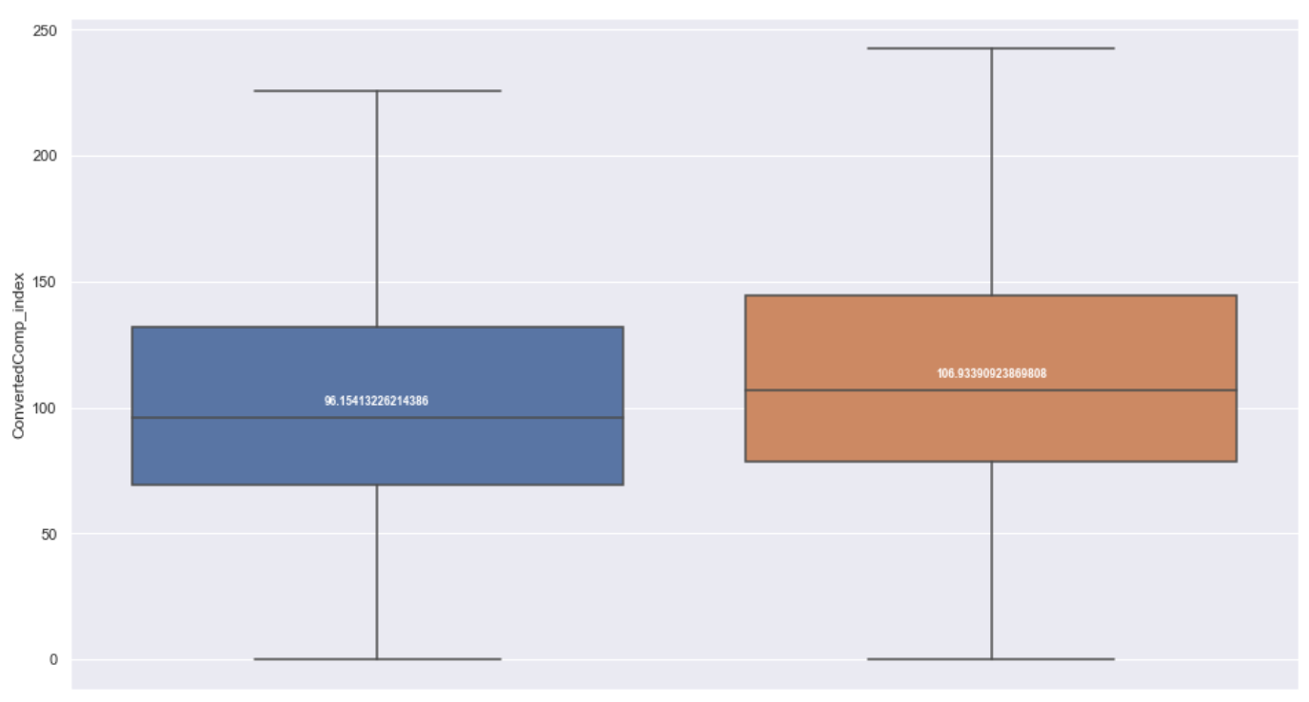

By DevType
Leverage: %7
Leverage: %6
Leverage: %11
Leverage: %16
Data Scientist / MLE
Backend Developer
Data Engineer
DevOps Engineer

Slide 12
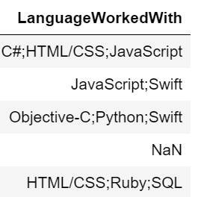
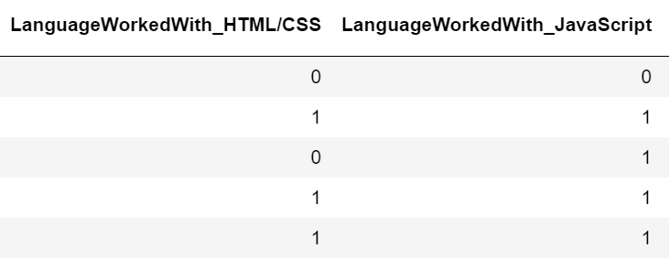
Data preparation
Out of scope
Processing multi-choice
Age > 90
Annual Compensation > $500.000
Annual Compensation < $100
Not professional developers
Countries that has less than 200 observation
No compensation information
Multi-choise columns processed with Apache Spark
For each selected item, a new column created with 1 otherwise 0.
Missing data handling
Processing categorical columns
Features with missing data filled with median value
Dummy variables are created for each categorical feature.
Outlier data handling
Precessed Data
Modeled Data
Raw Data
Age > 70: 70
YearsCodePro > 40: 40
Age1stCode > 30: 30
61 columns
64,461 rows
569 columns
21934 rows
403 columns
21934 rows
* Only in train set!

Slide 13
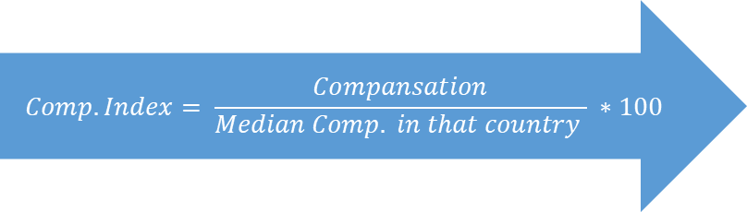
Target Transformation
Annual Comp.
Country A
Annual Comp. Index
50.000$
38.000$
27.000$
42.000$
24.000$
132
100
71
111
63
$$Comp. Index= \frac{Compansation}{Median Comp. in that country } ∗100$$
...
...
38.000$
Median
So, We can compare the factors affecting the compansation regardless of the country...

Slide 14
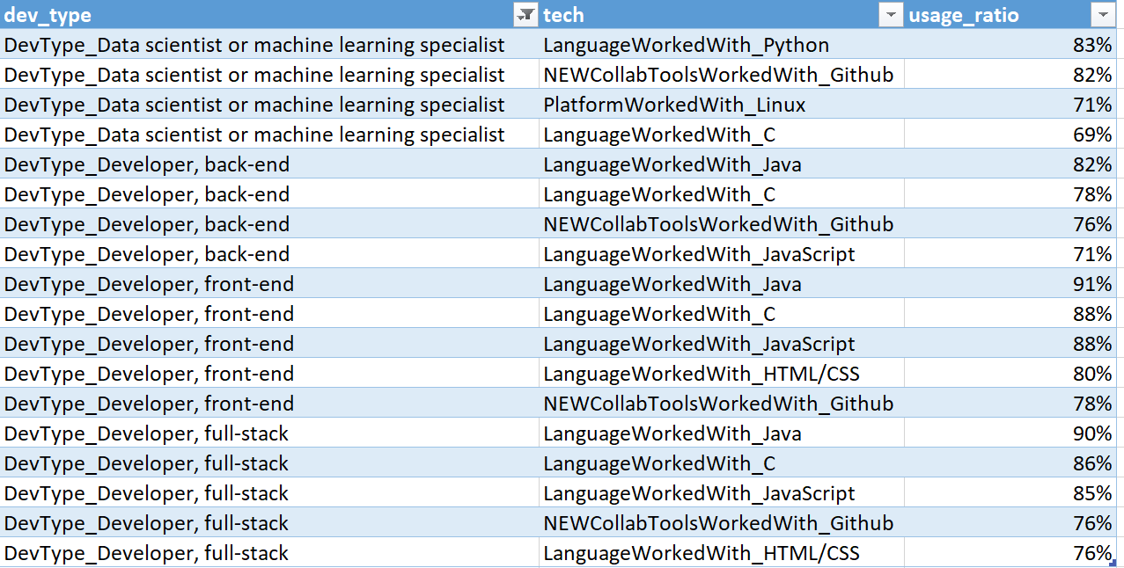
Aggregations: DevType - WorkedWith
Step1:
Commanly used technologies identified for each developer group has the.
Step2:
For each respondent, the rate of technologies used among commanly used technologies acording to dev type.
1
2
It’s been more than 30 years since
C programming language has been introduced but still widely used language in most of development roles
Version Control Systems can be considered standard way of collaboration in both enterprises and academia when Github’s usage ratio considered

Slide 15

Aggregations : High and Low Leverage Tech
High Leverage Tech
Low Leverage Tech
MiscTechWorkedWith_Chef
LanguageWorkedWith_Scala
MiscTechWorkedWith_Hadoop
DatabaseWorkedWith_Cassandra
MiscTechWorkedWith_Apache Spark
LanguageWorkedWith_Perl
LanguageWorkedWith_Objective-C
PlatformWorkedWith_IBM Cloud or Watson
DatabaseWorkedWith_DynamoDB
DatabaseWorkedWith_Couchbase
PlatformWorkedWith_AWS
PlatformWorkedWith_Kubernetes
NEWCollabToolsWorkedWith_Stack Overflow for Teams
LanguageWorkedWith_Go
LanguageWorkedWith_Dart
PlatformWorkedWith_MacOS
LanguageWorkedWith_Ruby
DatabaseWorkedWith_Redis
LanguageWorkedWith_Swift
LanguageWorkedWith_Julia
NEWCollabToolsWorkedWith_Jira
LanguageWorkedWith_C#
NEWCollabToolsWorkedWith_Gitlab
MiscTechWorkedWith_Cordova
DatabaseWorkedWith_MySQL
PlatformWorkedWith_WordPress
LanguageWorkedWith_SQL
PlatformWorkedWith_Arduino
LanguageWorkedWith_Java
WebframeWorkedWith_jQuery
PlatformWorkedWith_Windows
WebframeWorkedWith_Vue.js
DatabaseWorkedWith_MariaDB
MiscTechWorkedWith_Unreal Engine
LanguageWorkedWith_JavaScript
MiscTechWorkedWith_Unity 3D
LanguageWorkedWith_C
WebframeWorkedWith_Symfony
LanguageWorkedWith_HTML/CSS
LanguageWorkedWith_PHP
LanguageWorkedWith_Haskell
WebframeWorkedWith_Laravel
$$leveragetech= \frac{mean comp index users}{mean comp index not users} −1$$
Feature
How many of the high leverage technologies are used?

Slide 16
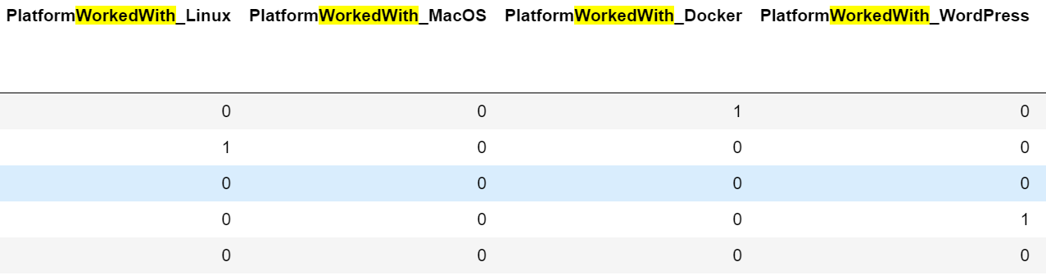
Aggregations : DesireNextYear WorkedWith
Features
How many of the possible options are chosen by developer?
WorkedWith
LanguageWorkedWith
PlatformDesireNextYear
WebframeDesireNextYear
DatabaseDesireNextYear
DesireNextYear
LanguageDesireNextYear
PlatformDesireNextYear
WebframeDesireNextYear
DatabaseDesireNextYear

Slide 17
Model
Data transformed with StandardScaler
Defined metrics to evaluate model performance.
Mean Absolute Percentage Error (mape),
Mean absolute error etc.
run_models function
Necessary models implemented
Feature elimination conducted
Return our index value prediction to original absolute value
RidgeCV
LassoCV
LinearSVR
LinearSVR (C=0.1)
LinearSVR (C=10)
SVR (Kernel = ‘rbf’)
DecisionTree •
RandomForest

Slide 18
Experimenting with target transformation and binning
Target transformation and binning is helpful
Included to the initial run.

Slide 19
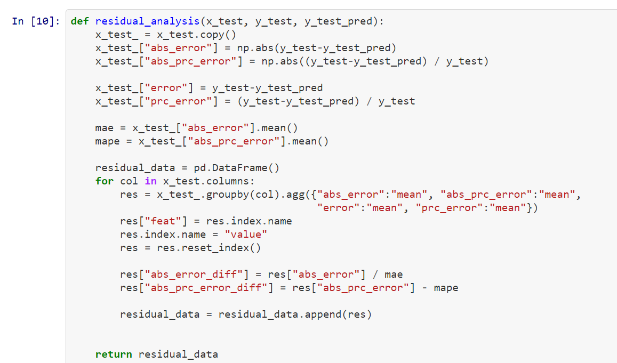
Residual Rate
To decide which values increase the error rate of model

Slide 20
Incorrect information in this survey.

Slide 21
It fits successfully until outlier values.
Until 200k US dollars per annum model predicts accurately

Slide 22
Experiment with target transformation and binning + feature aggregation
Mape result of LinearSVR decrease from 0,52 to 0,50.
It can be concluded that model performs better with feature aggregation.

Slide 24
Experiment with target transformation and binning + feature aggregation + aggregation of relevant tech group
Better results than initial run
Cannot beat result of only feature aggregation results

Slide 26
Overall performance of models
Performs best (mape error perspective)
Feature aggregation only
LinearSVR (c = 0,1)
Binning and target transformation creates big impact.

Slide 27
What does effect target attribute most?

Slide 28
Thank you for listening
?

